Slide 1
Who We are/What We Do
Department of For-Hire Vehicles
Supplemental Information and Data Points
Ernest Chrappah – Acting Director, Department of For-Hire Vehicles

Slide 2
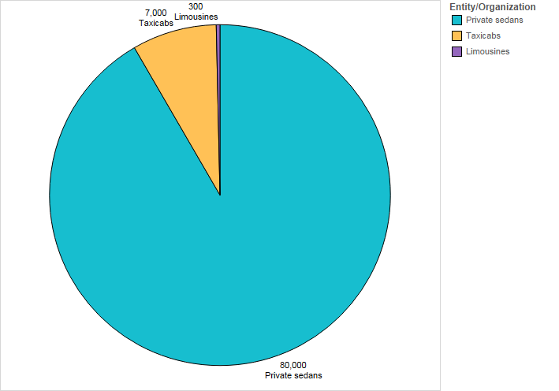
Who do we Regulate?
The Vehicle-For-Hire Innovation Amendment Act of 2014 has expanded the overall scope for the Office of Taxicabs.
Vehicle Type | Approx. # of Vehicles | Description
Private sedans | 100,000 (93.2%) | Uber, Lyft, Wheelz, Split, etc.
Taxicabs | 7,000 (6.5%) | 97 taxi companies (Yellow Cab, VIP, Grand Cab, etc.)
Limousines | 300 (0.3%) | Limousine companies
Note that Taxis and Limousine represent less than 10% of the vehicles in our ecosystem.
GOVERNMENT OF THE DISTRICT OF COLUMBIA
Executive Office of Mayor Muriel Bowser

Slide 3
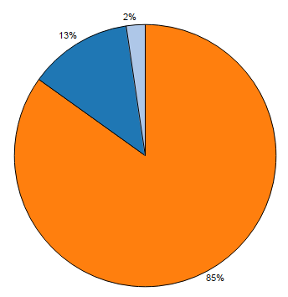
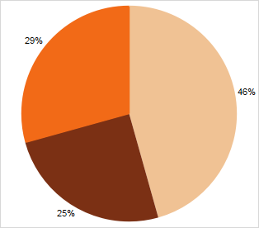
How is the Agency Funded?
FY16 Approved Budget
FY16 Special Purpose Revenue
Breakdown of Special Purpose Revenue
Licensing and Fees
Digital Dispatch (Uber, Lyft, etc)
Taxi Surcharge
Note that the private vehicle-for-hire industry (Uber, Lyft, etc.) contributes 25% toward the agency’s special purpose revenue.
GOVERNMENT OF THE DISTRICT OF COLUMBIA
Executive Office of Mayor Muriel Bowser

Slide 4
What Relationships do we Manage?
Taxicab Companies
Dispatch Companies
Regulatory authority for taxicab companies. Monitoring compliance in areas such as vehicle safety, vehicle age, insurance requirements, cleanliness and color-scheme.
The agency partners with local dispatch companies to facilitate requests for transportation services for programs such as Transport-DC (ParaTransit).
Private Vehicle-for-Hire Companies
Regulatory authority for Uber, Lyft, Wheelz, Split, and others. As part of regulatory compliance, these organizations are required to submit 1% of their gross revenues to the agency each quarter.
Insurance Companies
The agency certifies taxicab insurance providers and connects taxicab companies and independent operators to insurance providers.
Payment Service Providers (PSP)
The agency collects information on trips, including starting point, destination, and fare information from PSPs and also sets standards for in-vehicle equipment (such as the driver safety feature) that is provided by PSPs.
Equipment Manufactures
The agency works with equipment manufactures and providers to ensure fair and equitable treatment for passengers, ensuring that taximeters are appropriately calibrated and certified by their provider.
GOVERNMENT OF THE DISTRICT OF COLUMBIA
Executive Office of Mayor Muriel Bowser

Slide 5
What Services do we Provide?
We provides a number of services to enhance the overall experience of our stakeholders including:
Lost and Found
Complaint Resolution
24/7 Street Enforcement
Driver and Vehicle Licensing
Grants Administration
Partners with taxicab companies and launched an online form for passengers to report and recover items lost in a DC taxicab.
Reviews, researches, and adjudicates complaints submitted against vehicle operators, taxicab companies, payment service providers, or dispatch companies. Our compliant resolution process covers digital dispatch providers, such as Uber and Lyft.
Enforcement staff is responsible for the for safe and responsible operating of taxicabs and ensuring compliance with Title 31 regulations.
Processes applicants for a Taxicab and/or Sedan or Limousine Operator’s Licenses in addition to registering and licensing public vehicles for hire and luxury vehicles.
The agency administers grants to incentivize the purchase of Wheelchair Accessible Vehicles (WAVs), Electric Taxis, as well as a neighborhood shuttle for underserved communities.
Paratransit Services
Provides Paratransit services for MetroAccess-eligible persons with disabilities through the Transport-DC program, allowing point to point transportation services with only a one-hour lead time for requests.
Some examples of what the agency is NOT includes:
We are NOT a cab company
We are NOT a dispatch company
We do NOT employ vehicle operators
We do NOT employ dispatchers
We do NOT lease or own taxicabs
We do NOT compete with taxicab companies or private companies such as Uber and Lyft
GOVERNMENT OF THE DISTRICT OF COLUMBIA
Executive Office of Mayor Muriel Bowser

